Slide 1





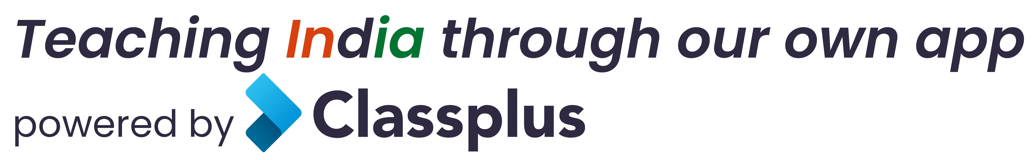


VIII-XII - All Subjects & Boards
NEET, IIT-JEE (Mains & Advanced)
ARTIFICIAL INTELLIGENCE – Class III – XII
IT & AI Professional Training & Projects
MBA, BBA, Bcom, CA, CMA, CS, CFA, CLAT, LLB, LLM
Grooming, Ielts, Toefl, Foreign Languages
Finest Teachers, Study Materials, Mock Tests, Doubt Clearing, PTM, Counselling
400+ Courses, 20 Smart Classrooms, AC, CCTV
Professional Courses are Project-Based, Certification-Oriented & Job-Focused
N-1/25 Patuli, Kol 94
9073 700094
www.anodiam.com anirban@anodiam.com

